Slide 1
Data viz
Principles and Best Practices
Jake Riley

Slide 2

AGENDA
What is data visualization
Best practices
Dashboards
Controversies
My thoughts
Please ask questions as they come up

Slide 3
What is data visualization?
“Data visualization is the graphic representation of data. It involves producing images that communicate relationships among the represented data to viewers of the images.” - Wikipedia
introduction

Slide 4
Goals of data visualization
Evokes a feeling
Gives a sense of the story without needing to see all values
Adds context to a data point
Helps make a decision
introduction

Slide 5
3 Main Takeaways
Reduce distraction
Help your audience
Golden Ratio

Slide 6
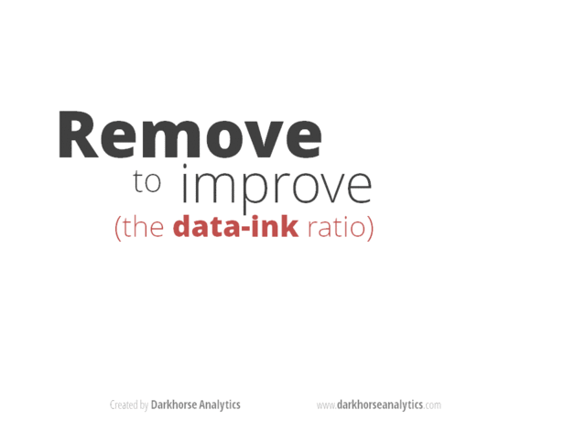
Reduce distraction
reduce distraction

Slide 7
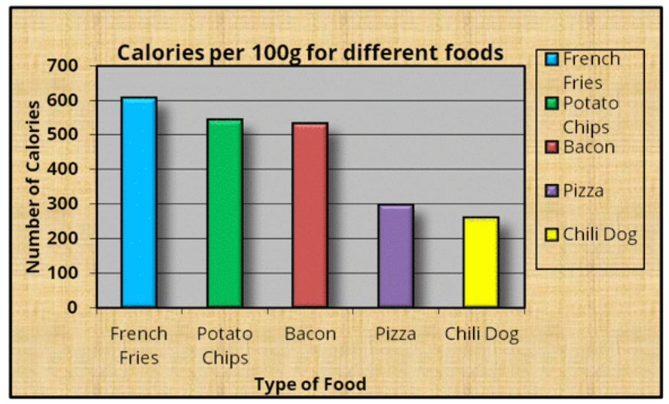
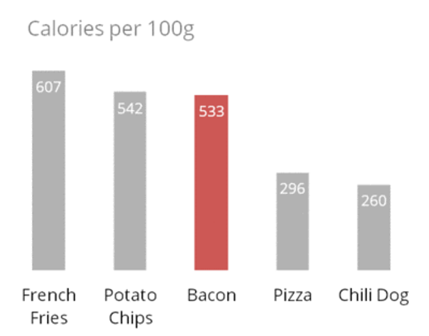
Reduce distraction: the data-ink ratio
How much of the ink on the page is related to the take-away?
How much is context or distracting?
reduce distraction

Slide 8
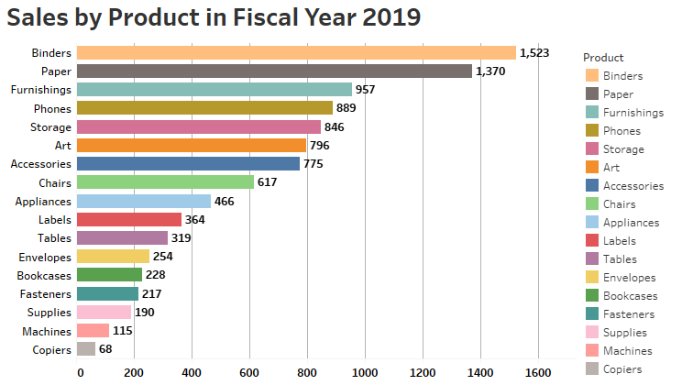
Reduce distraction
What should we be paying attention to?
reduce distraction
¯\_(ツ)_/¯
Notes:
This chart isn’t terrible but I wouldn’t put it in a presentation.
What is the takeaway?
What should I focus on?

Slide 9
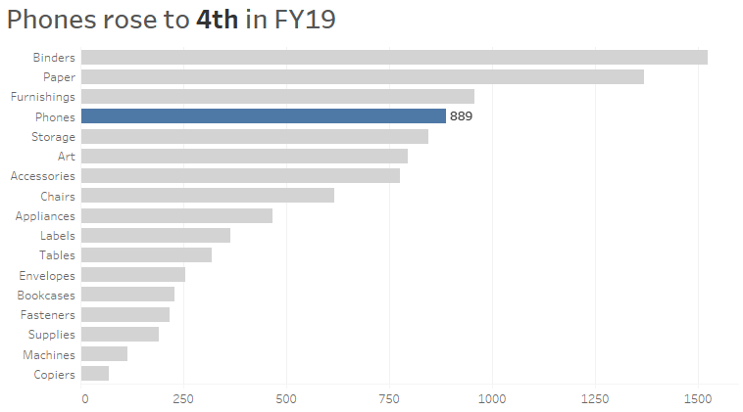
Reduce distraction: highlight the takeaway
What about this one?
help your audience
Notes:
Hopefully this chart is clearer.
Right away, the title is informing you of the take away: phone sales have risen to 4th place.
The chart is still there, I have put the bars in context of the other products, but by making the phone category a different, darker color, your eye should go right to it.
I don’t need to know the exact values of each point.
I just need to know that phones are fourth and there is a lot of work to do if I want it to reach first place ~1500.

Slide 10
Help your audience: modifications
Informative title: tell your audience what the takeaway is right away
Removed: nice to know, but distracts from the story
Removed: redundant since labels on axis
Changed from black to grey: they provide context but aren’t the main focus
help your audience
Notes:
Do you remember this chart?
I want to talk about how I got there

Slide 11
Help your audience
help your audience

Slide 12
Not just for data viz
Here is a lot of text on a slide
Here is some advice I would like to share with you:
First, adjust font color and bold text to highlight the main point of each phrase
This will help your audience focus on each point without getting lost in the paragraphs of text
Second, say more with less by using pictures and shorter sentences will help your audience stay focused
Third, space things out so the text doesn’t run together
Everything is black and nothing stands out.
This slide is easy to follow
Using these tips will help your audience stay focused:
Adjust font color and bold text to highlight the main point
Use pictures and shorter sentences to say more with less
Add space between each points
Notes:
Hopefully you’ve noticed so far that these principles help with presentations as well.
These slides have the same information but their impact on the viewer is very different.
The risk of the slide on the left is that you will lose your audience

Slide 13
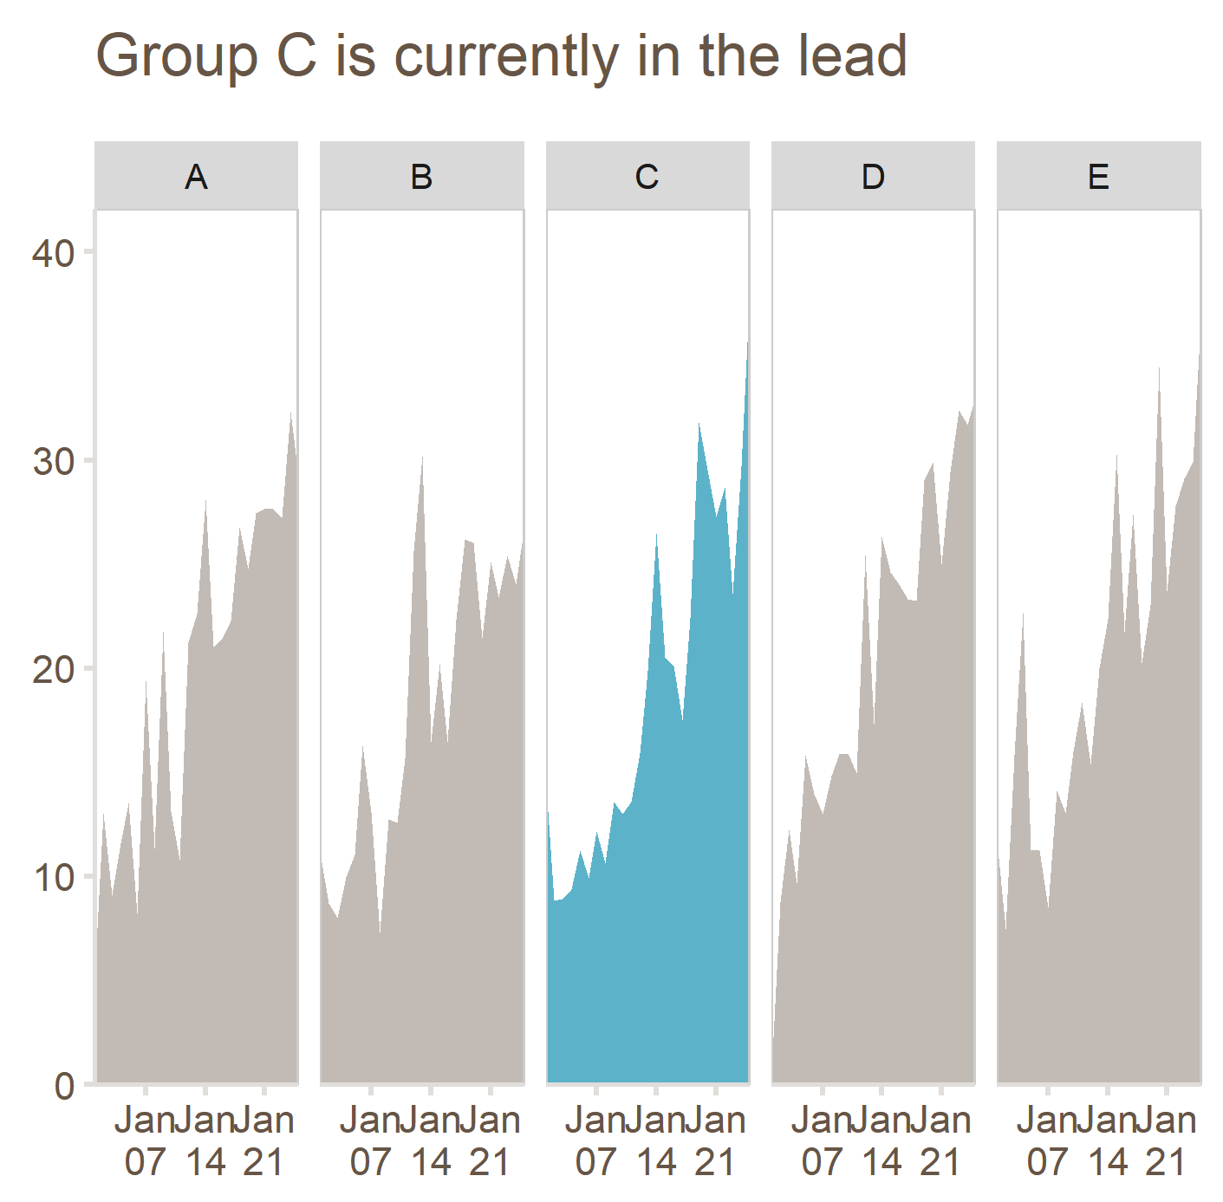
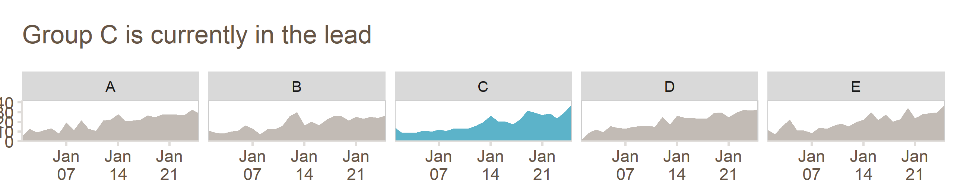
Proportions matter
If your chart is too stretched or too squished, the story will be hard to see
golden ratio

Slide 14
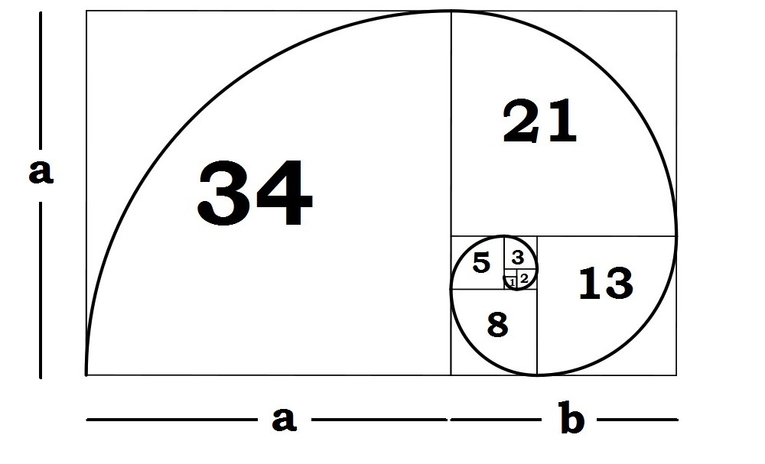
Golden Ratio
1 : 1.61803398875
0 + 1 = 1
1 + 1 = 2
1 + 2 = 3
2 + 3 = 5
3 + 5 = 8
5 + 8 = 13
8 + 13 = 21
13 + 21 = 34
golden ratio
Notes:
This is called the golden spiral

Slide 15
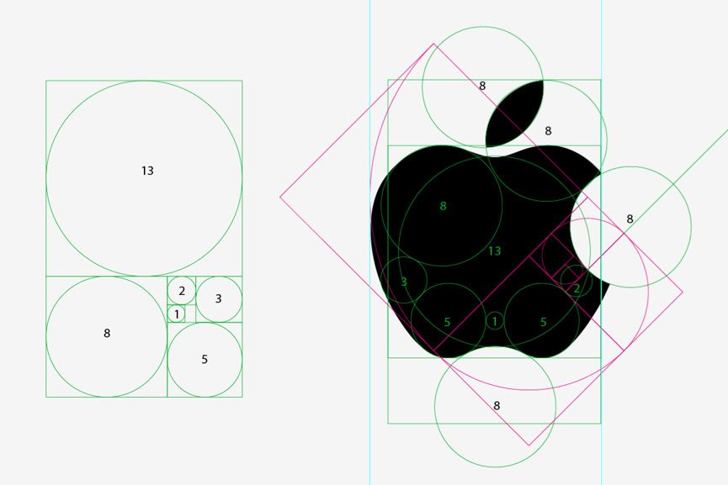

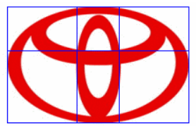
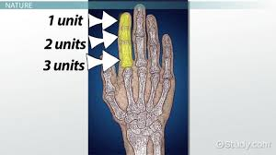

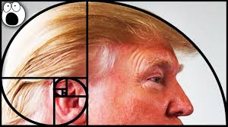

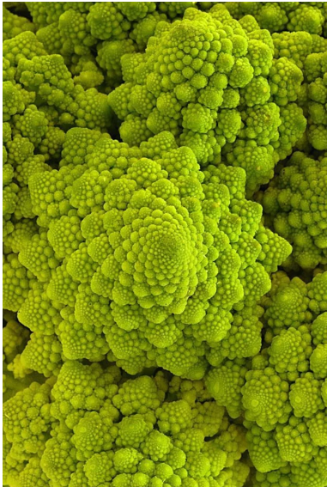
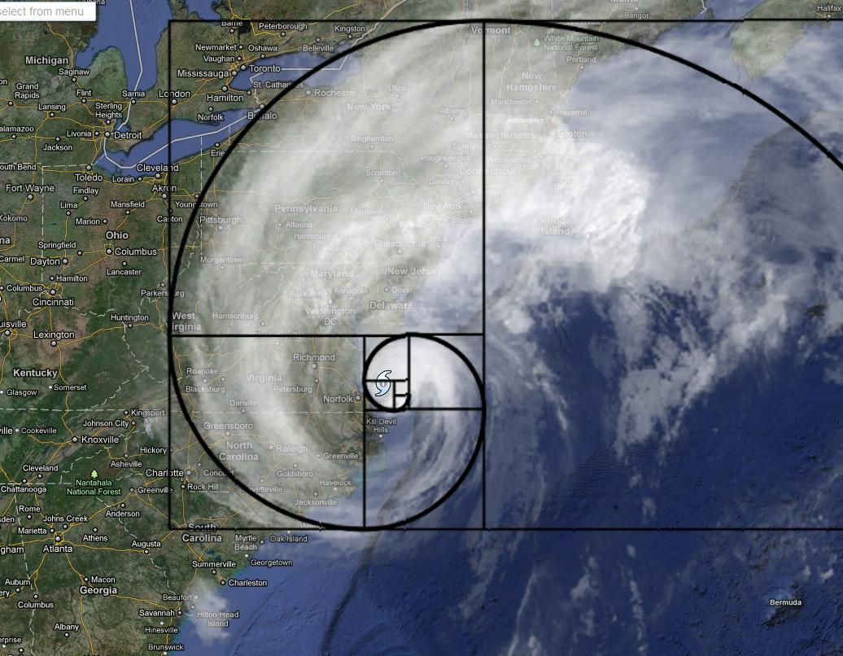
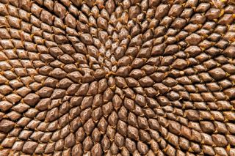

… and it is everywhere
golden ratio
Notes:
The one I find most interesting is the bones in our fingers

Slide 16
Let’s put these principles into practice

Slide 17
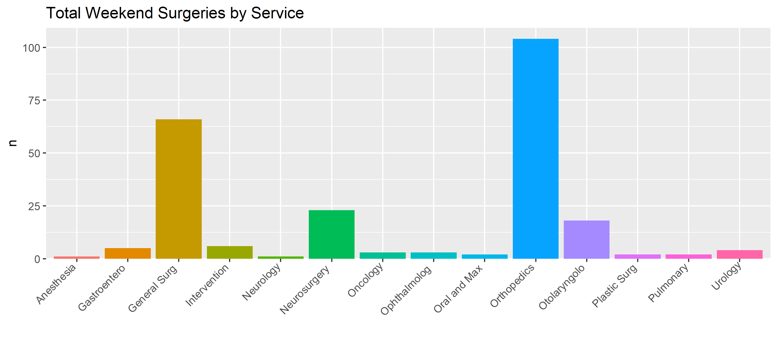
Bar charts
Notes:
This is data from roqci

Slide 18
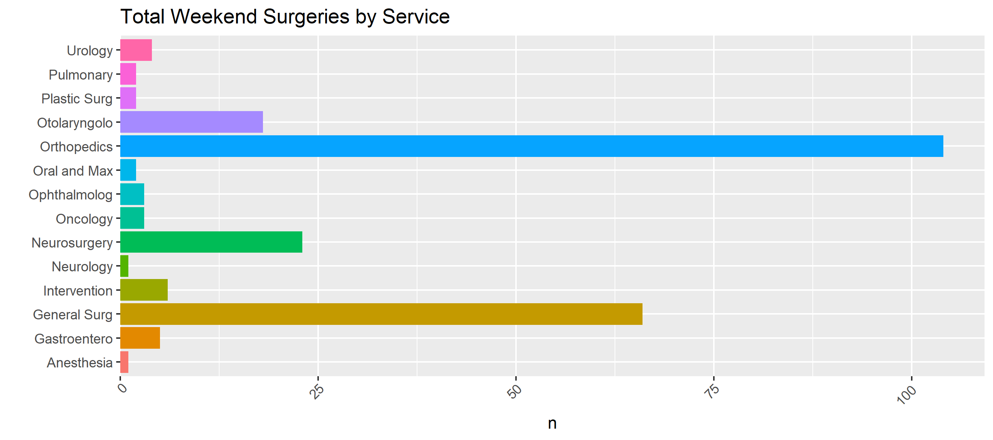
Bar charts: flip categorical data
Notes:
The very first thing I would do is to flip the chart so the x-axis doesn’t require me to tilt my head

Slide 19
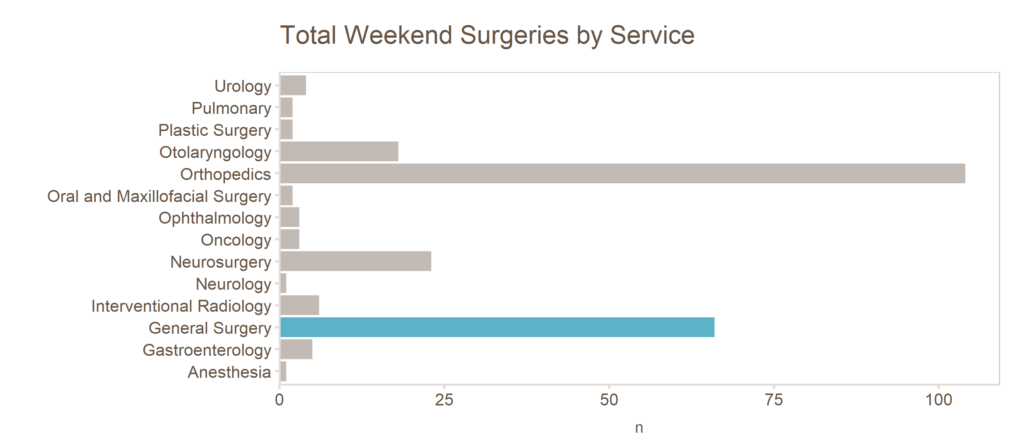
Bar charts: reduce distraction
Notes:
Removed grey background
Highlighted the takeaway

Slide 20
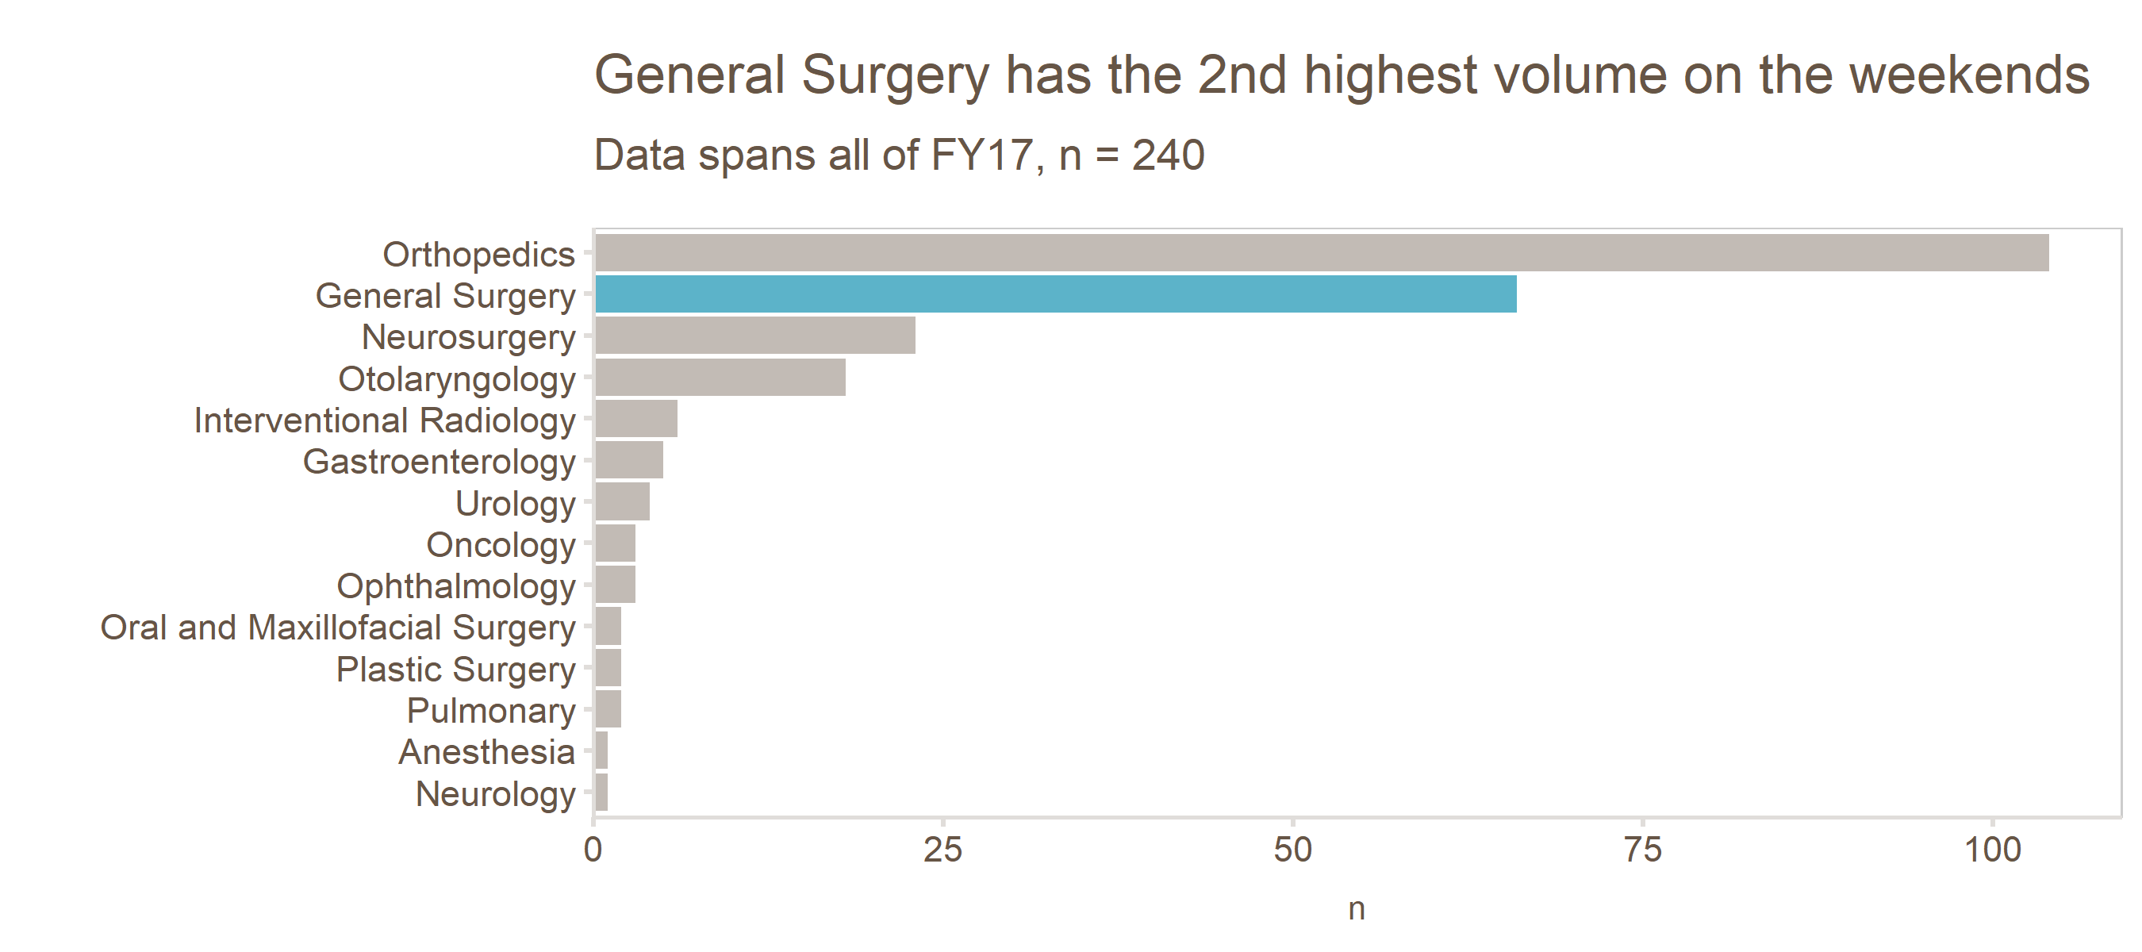
Bar charts: help your audience

Slide 21
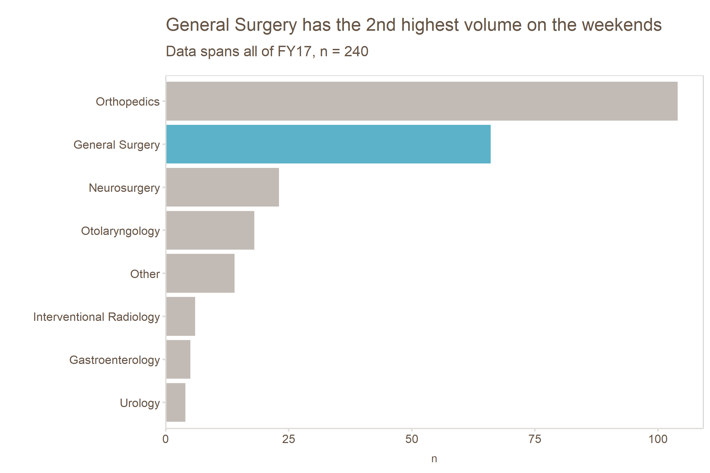
Bar charts: golden ratio

Slide 22
Bar charts: comparison

Slide 23
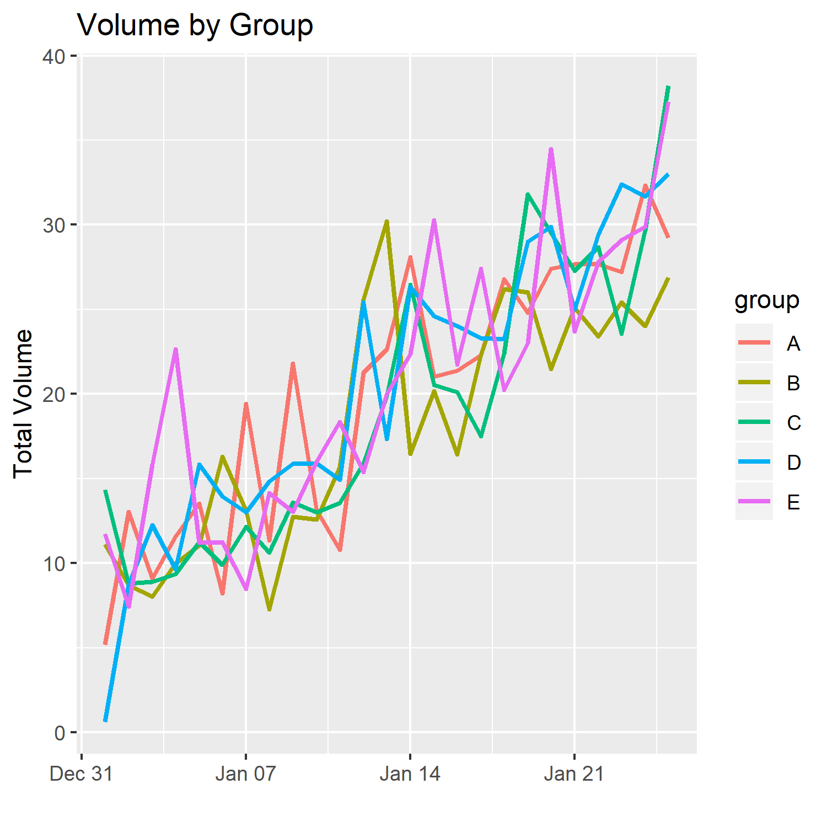
Spaghetti charts

Slide 24
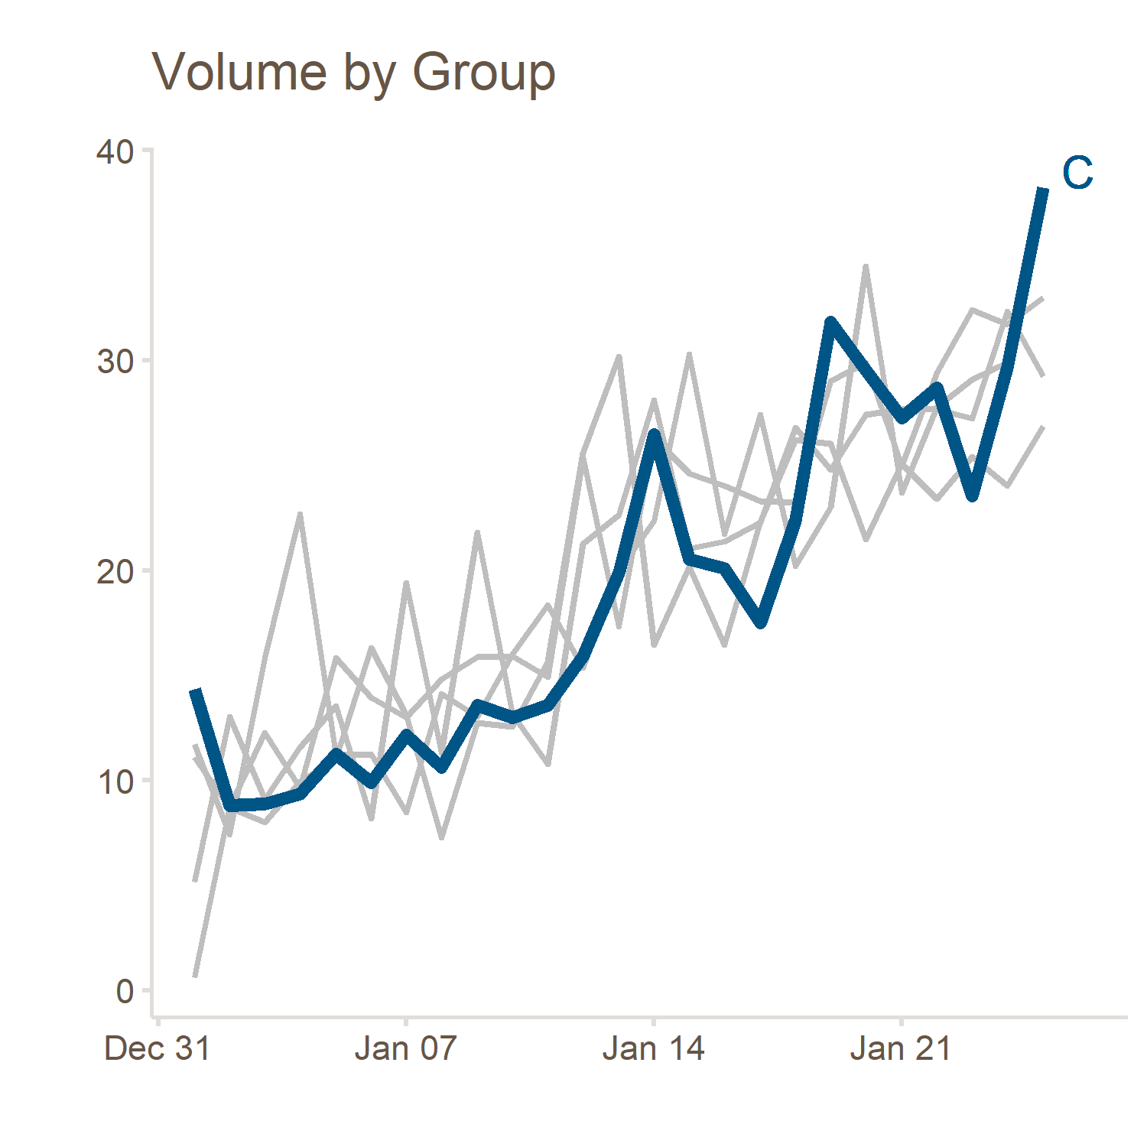
Spaghetti charts: reduce distraction

Slide 25
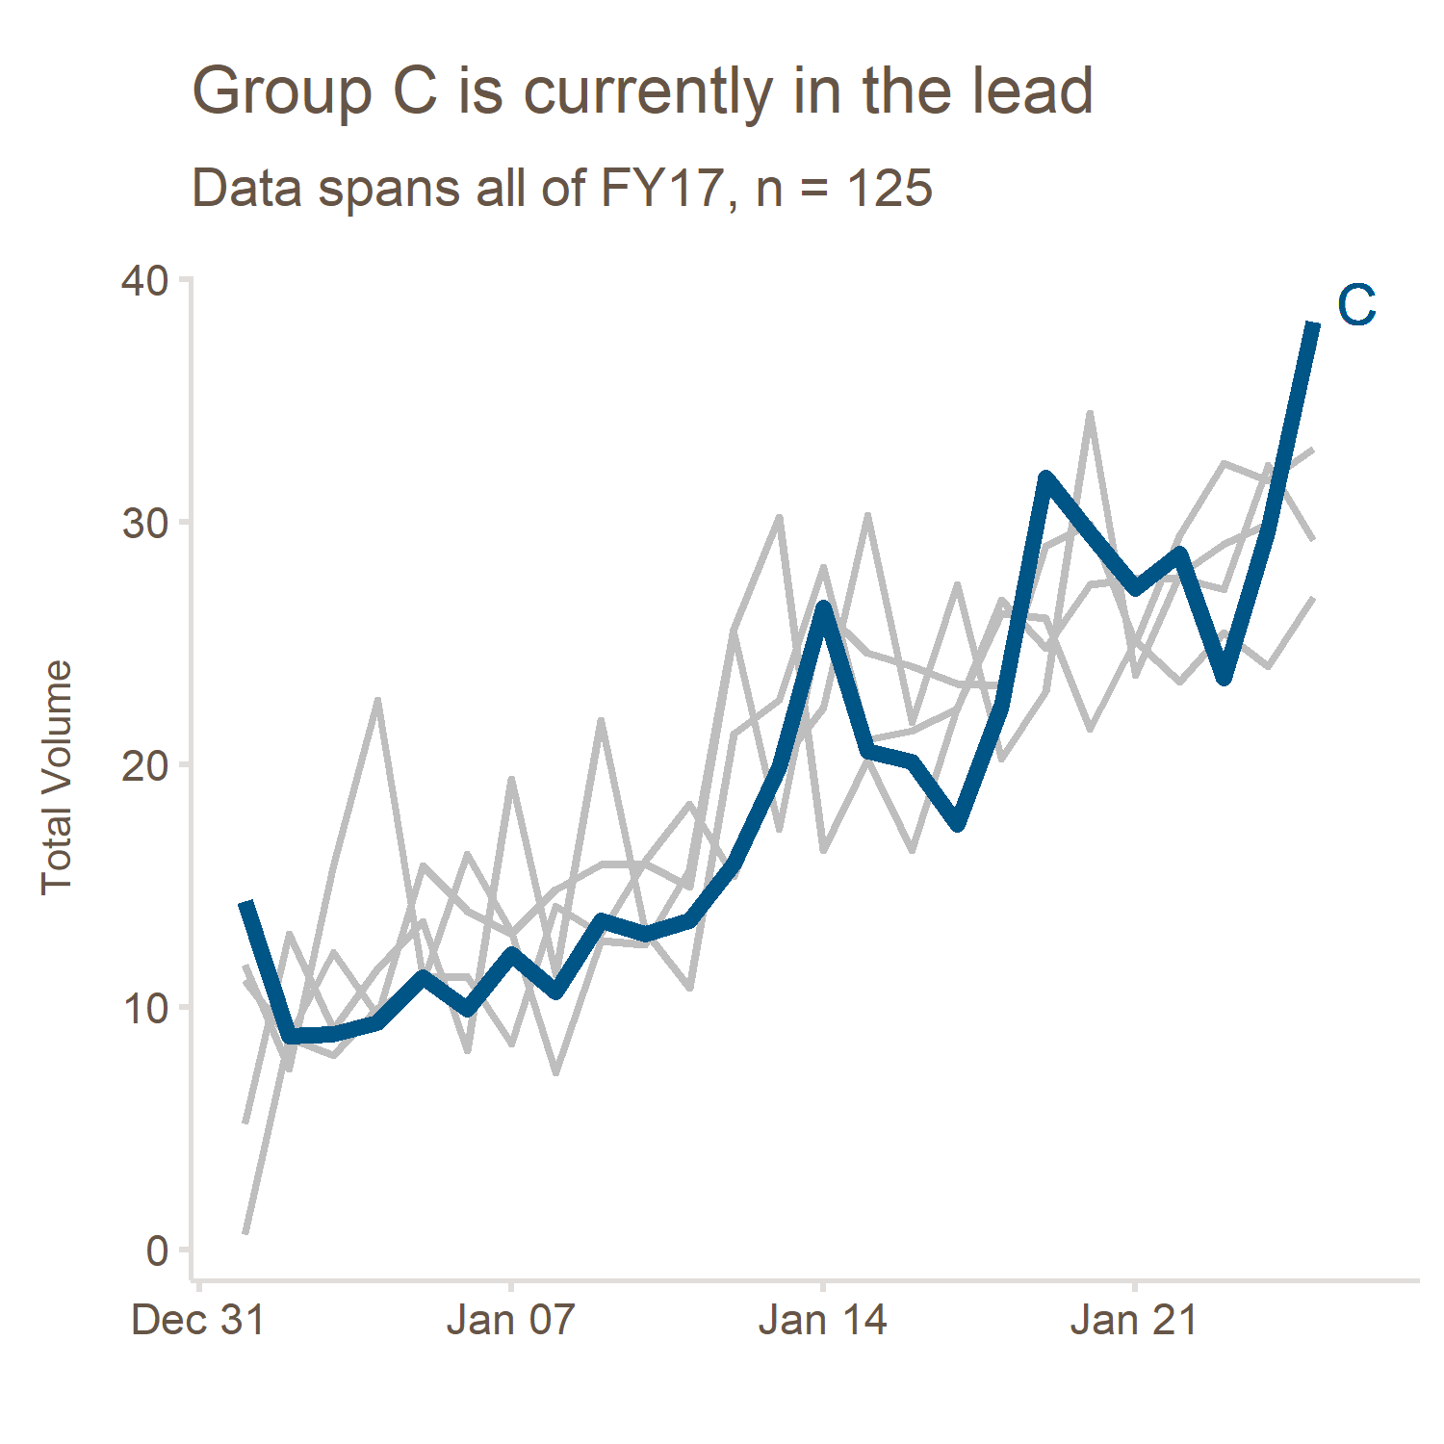
Spaghetti charts: help your audience

Slide 26
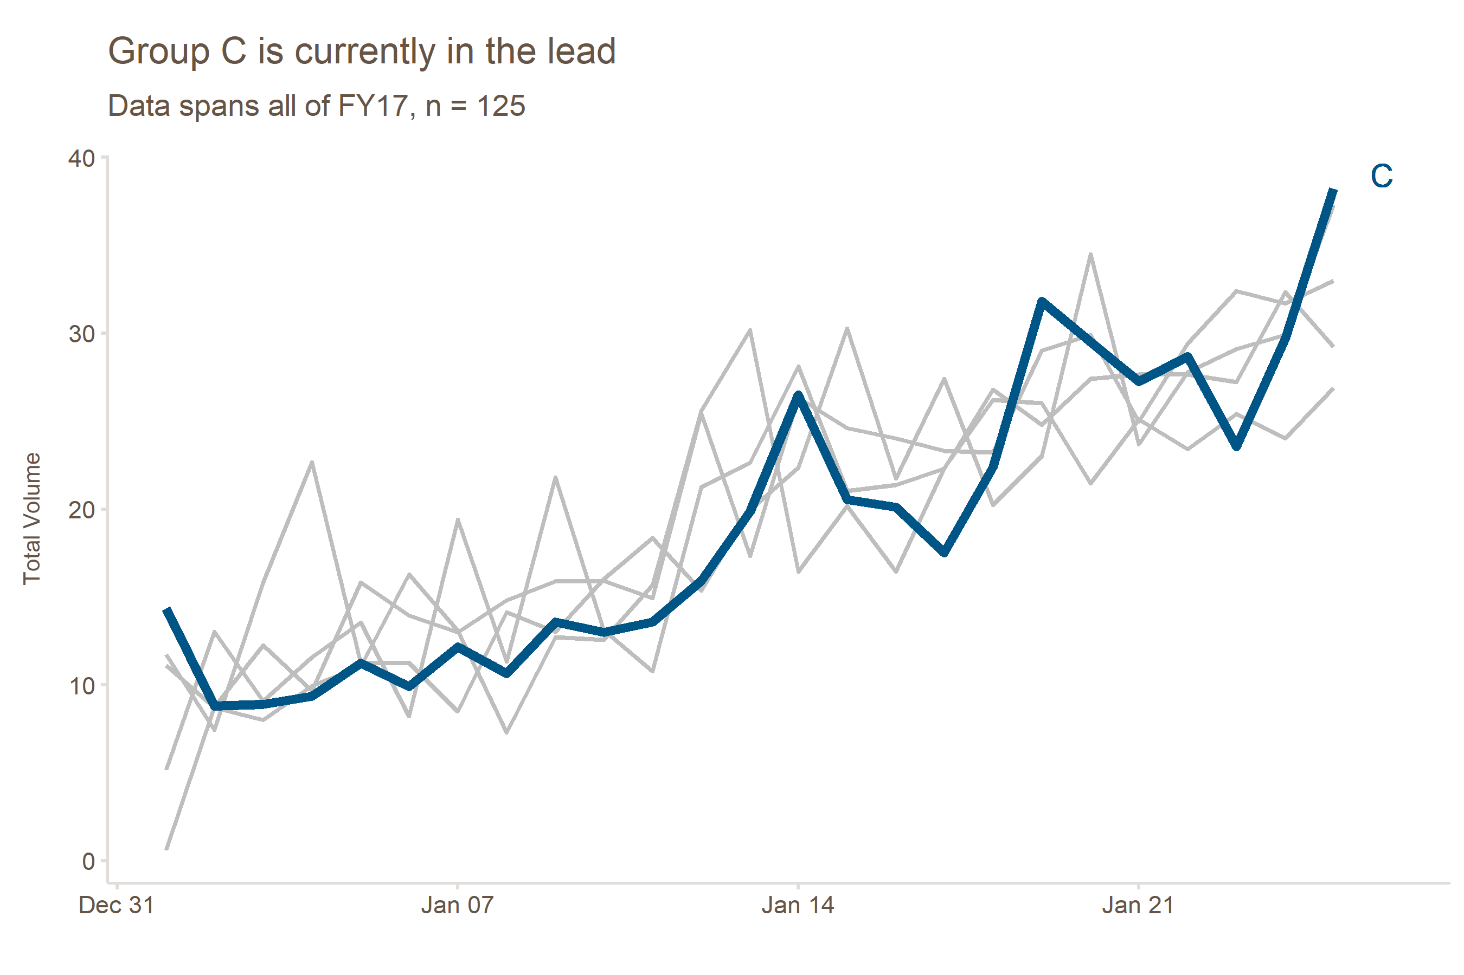
Spaghetti charts: golden ratio

Slide 27
Spaghetti charts: comparison

Slide 28
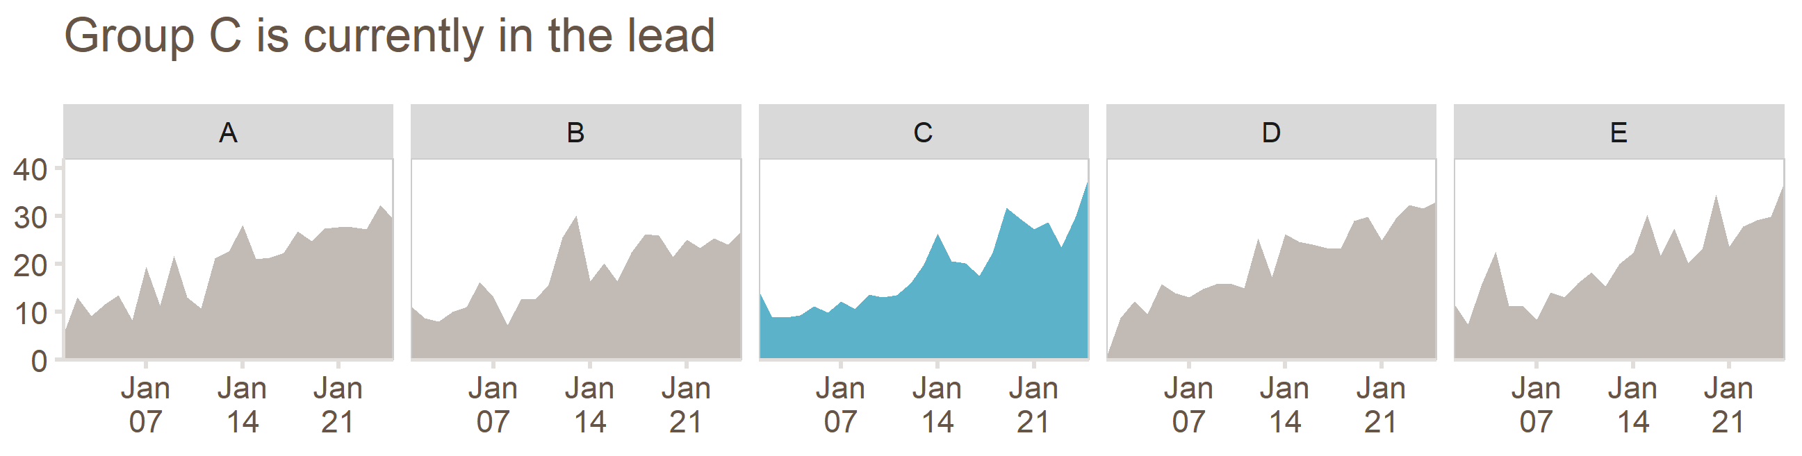
Spaghetti charts: separate them

Slide 29
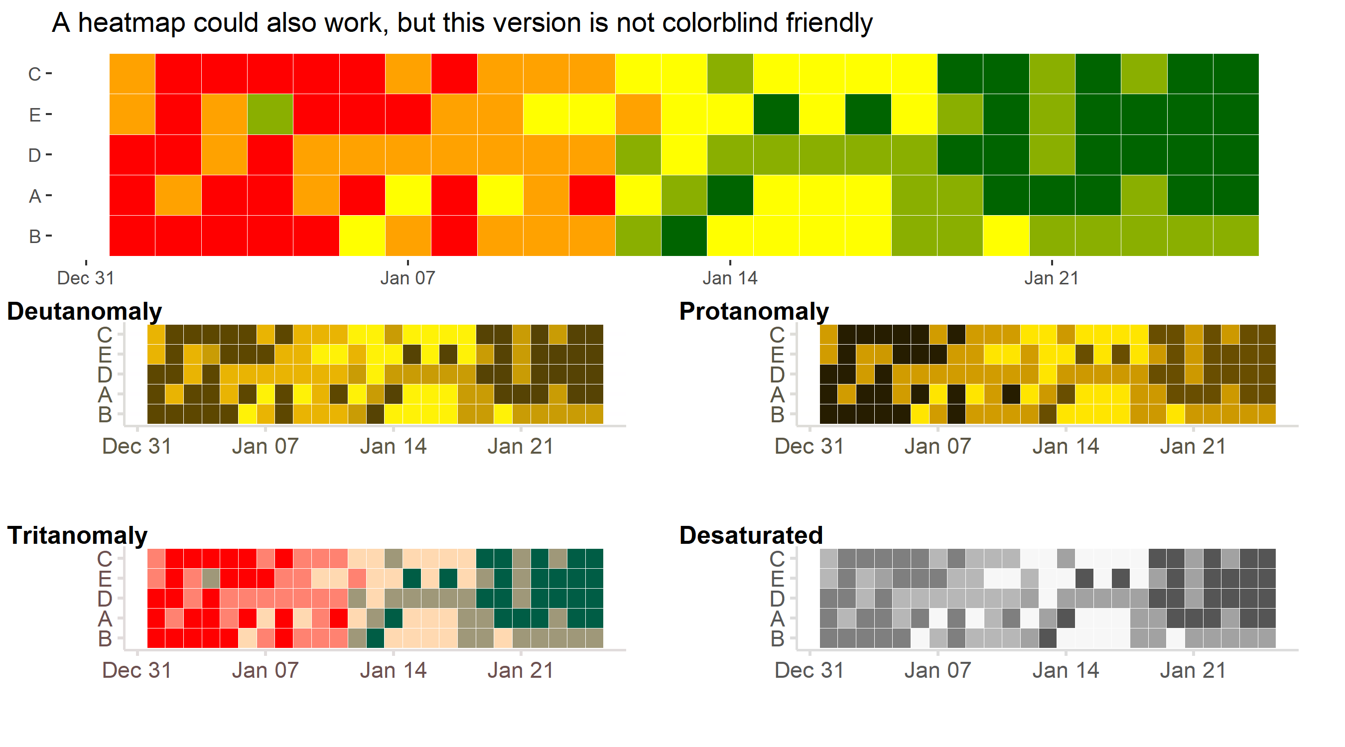
Spaghetti charts: heatmaps
BEWARE
accessibility
Strong colors will fight for your user’s attention
Not everyone can see the story

Slide 30
Heatmaps: accessibility
10% of men are colorblind
There is no excuse not to aim for accessibility
There are 3 colorblind people in CHQA (that I know of)
Traffic-light colors are only popular because they are familiar
Accessibility
https://github.com/clauswilke/colorblindr
Notes:
Also, the desaturated view shows that this chart wouldn’t print well in black & white
I’m using colorblindr here

Slide 31
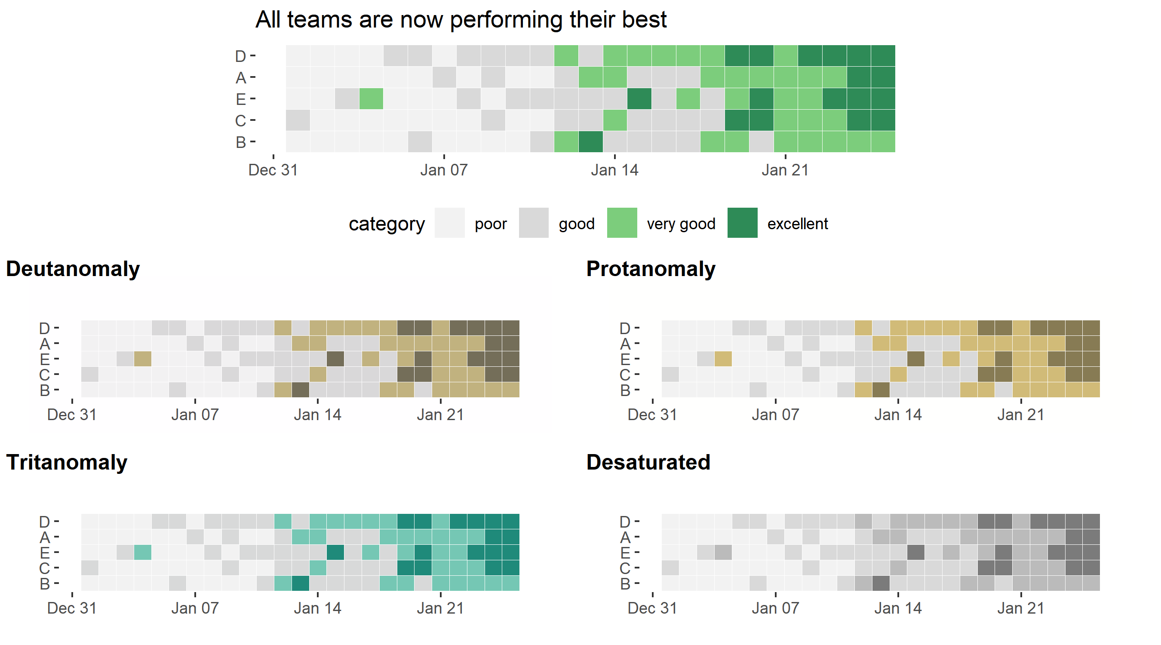
Heatmaps: highlight the good
accessibility

Slide 32
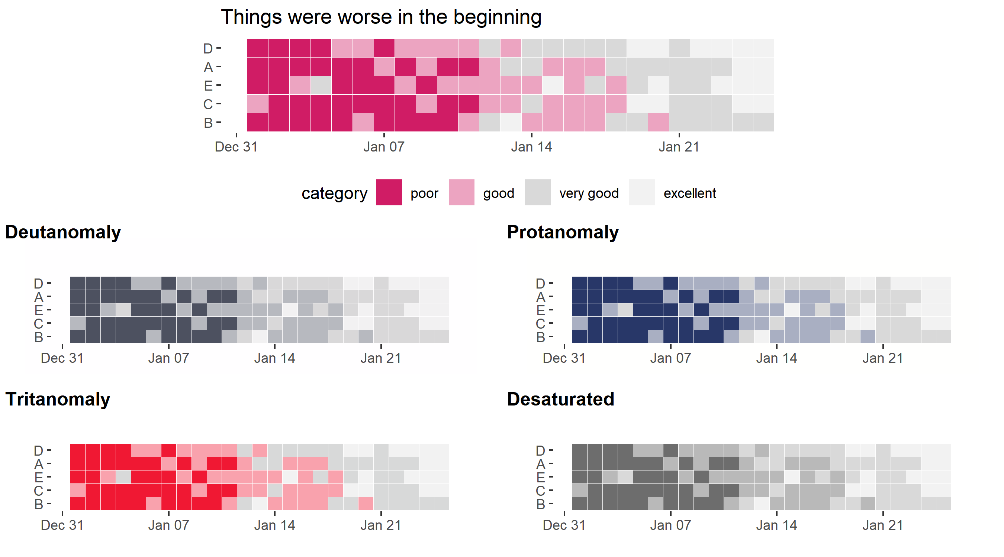
Heatmaps: highlight the bad
accessibility

Slide 33
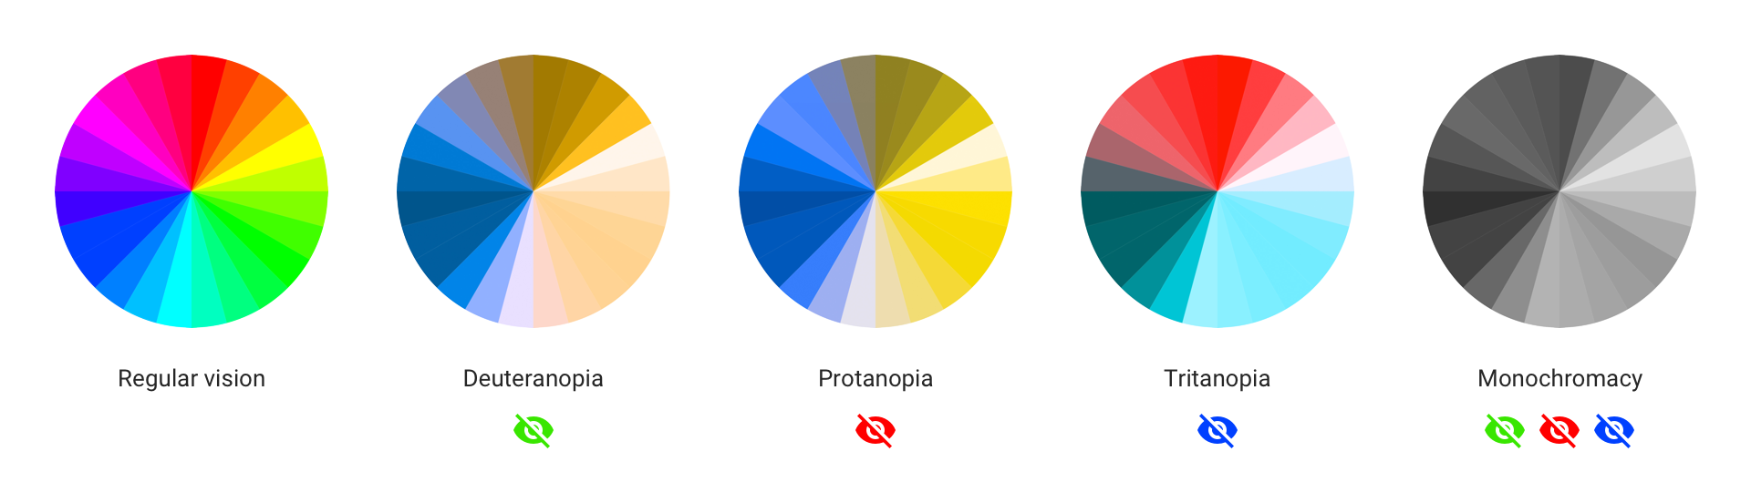
Heatmaps: universal colors
Keep in mind: nearly everyone can see orange and blue
accessibility

Slide 34
Dashboards

Slide 35
Two types of dashboards
Exploratory
Dynamic
Drilldown & filter data
Expository
Static
Conclusions obvious
dashboards
Notes:
I consider dashboards to be on a spectrum between exploratory and expository
I think there are opportunities for us to incorporate more expository components

Slide 36
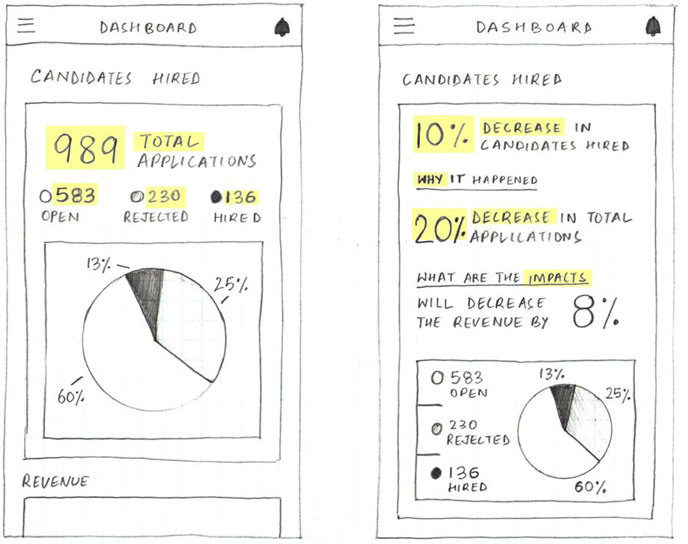
Goals of a dashboard
facts
insights
introduction
https://blog.prototypr.io/dashboard-design-5-things-every-ux-designer-should-know-a85c4558d75
Notes:
These two dashboards use the same underlying data however
In the chart on the left:
- Insights are not obvious
- User needs to form their own conclusions

Slide 37
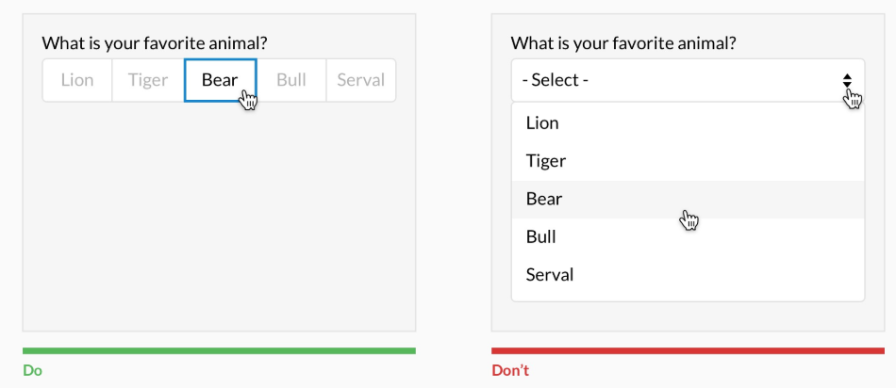
Buttons over dropdowns
The more your user has to click, the less likely they will
Dropdowns require 2x clicks than buttons
OK if there are > 7 options
dashboards
https://uxdesign.cc/design-better-forms-96fadca0f49c
Notes:
Help your audience to interact with as much of your dashboard as possible

Slide 38
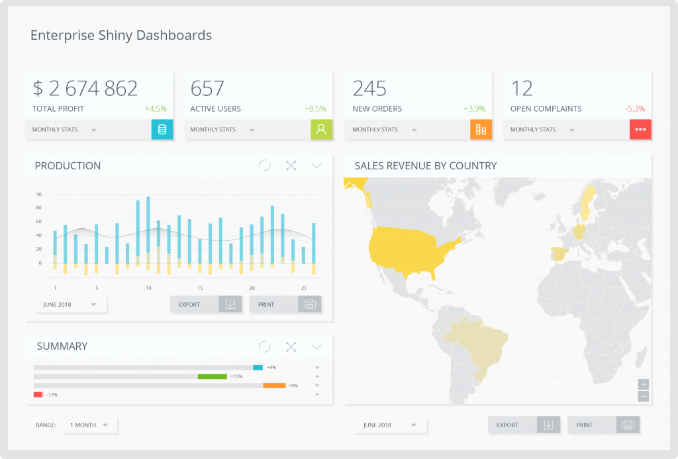
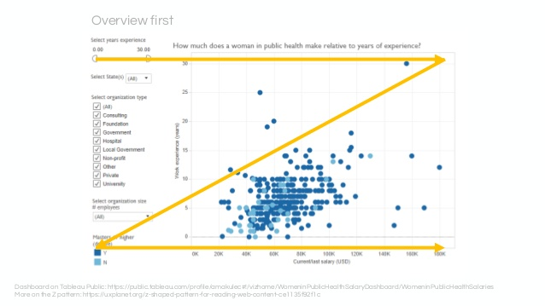
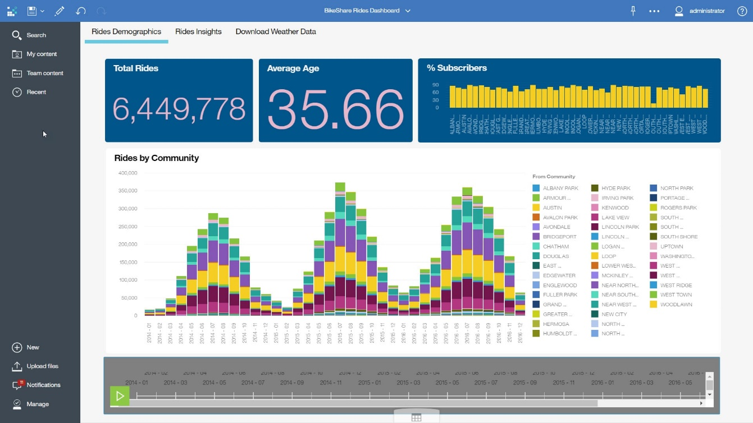
Keep a Z pattern in mind

Slide 39
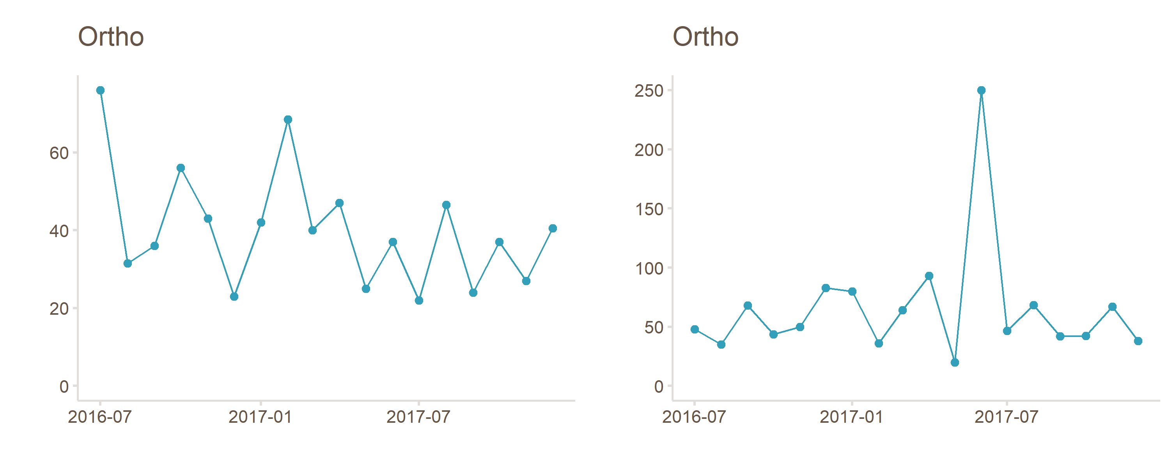
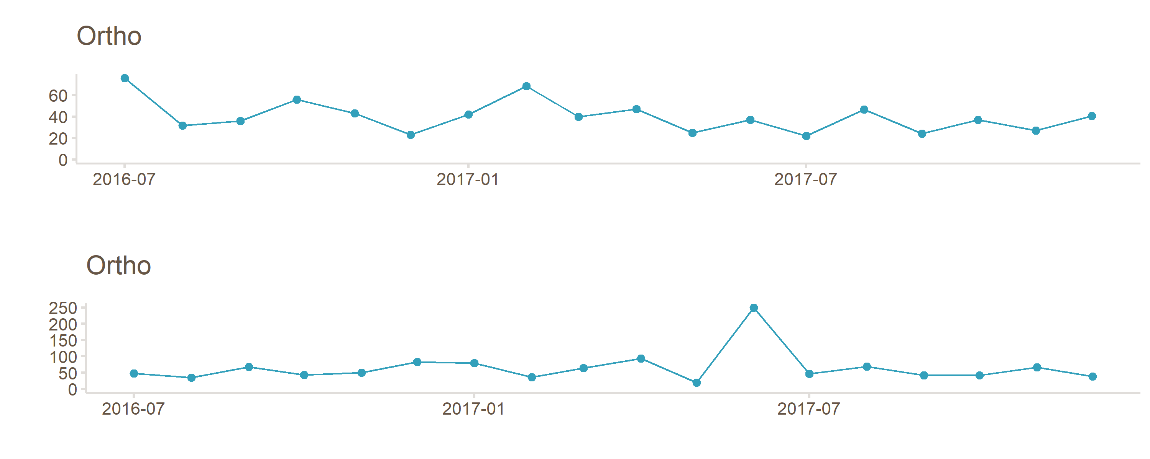
Columns over rows

Slide 40
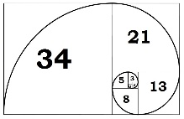
Columns over rows

Slide 41
Columns over rows

Slide 42
Controversies

Slide 43
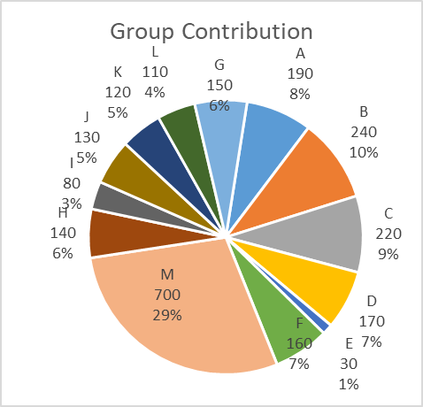
Pie charts: controversy
We’re not good at calculating area
Too many slices I don’t think much needs to be said here
People go slice by slice to read each value and it defeats the goal
controversy
Notes:
There are a lot of strong opinions on whether we should be using them.
Many people think it’s a fast and easy way to display data.
On the other hand, discourse in the data viz community generally says that bar charts are better and here’s why:

Slide 44
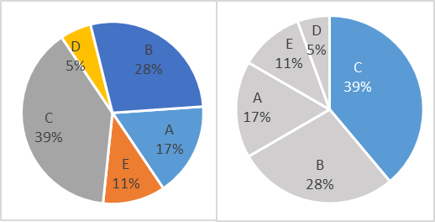
Pie charts: how to use
Start at 12:00
Biggest to smallest
Max of 5 slices
Highlight the takeaway that C dominates
controversy
Notes:
Ok, pie charts. There are a lot of strong opinions on whether we should be using them. Many people think it’s a fast and easy way to display data. On the other hand, discourse in the data viz community generally says that bar charts are better and here’s why:

Slide 45
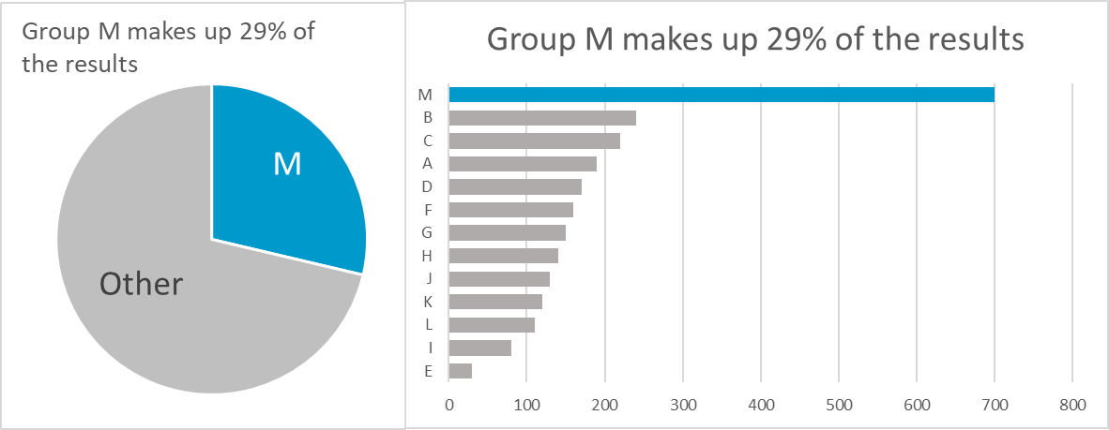
Pie charts: how to use
Here are some other ways you might represent the data
controversy

Slide 46
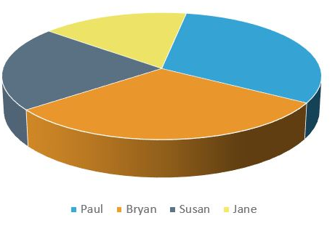

3D charts: controversy
Hard to read
Depth doesn’t add value
Bad data-ink ratio
These slices “show” the same area!!!
controversy
Notes:
Although Excel has made it easy to create 3D graphs you should keep things 2D

Slide 47
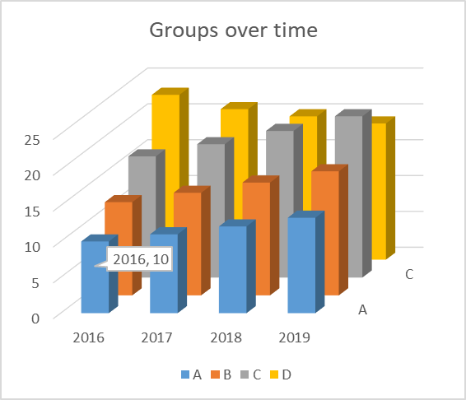
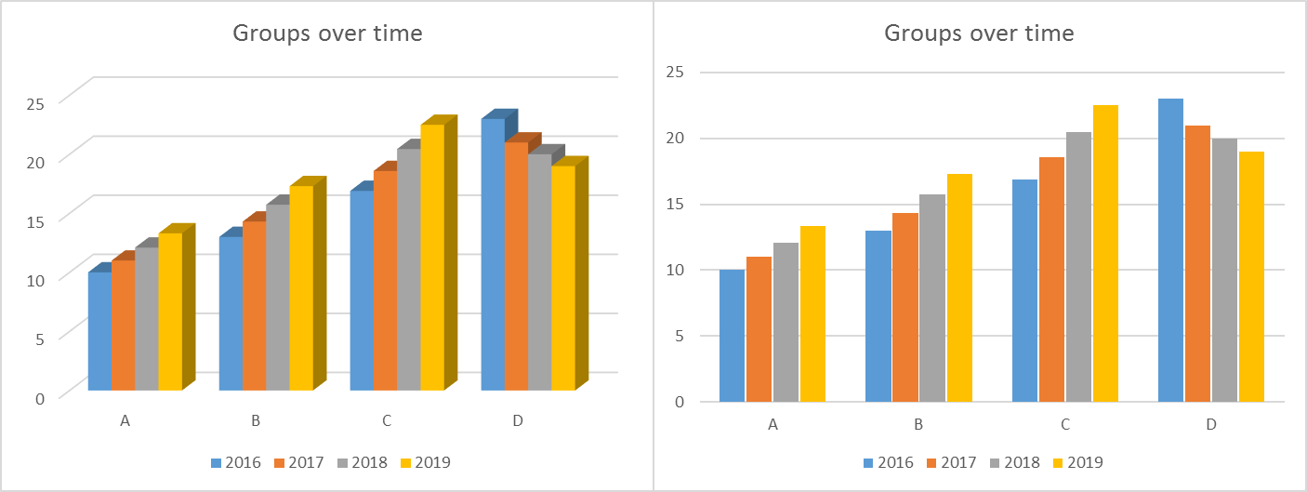
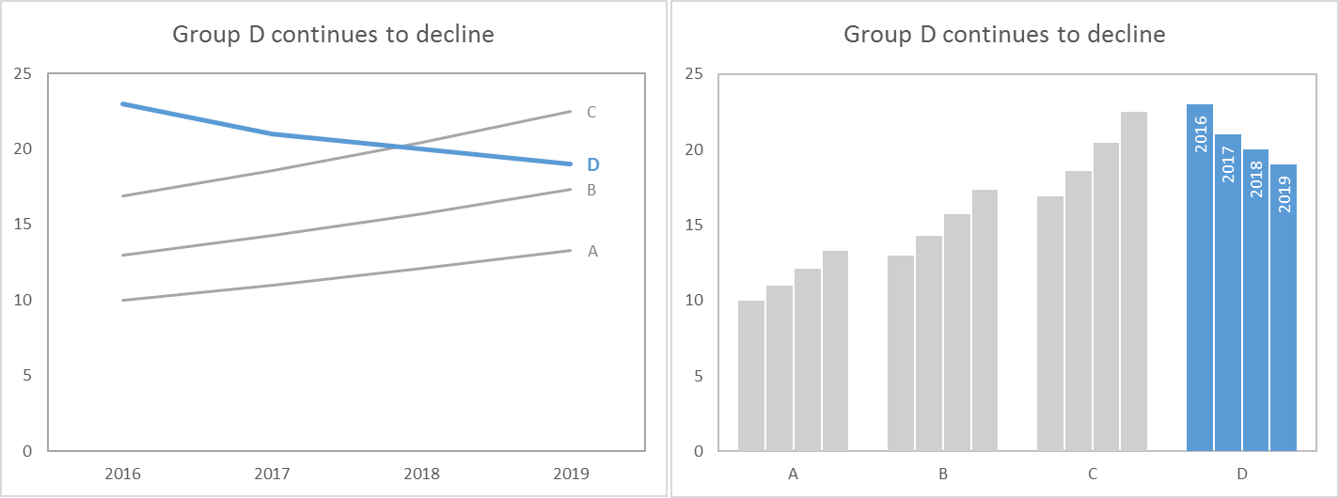
3D Charts: what to do instead
controversy
Notes:
3D charts can make it difficult to tell where the tops of the bars line up. For example, in the chart below, the fact that group A has a value of 10 in 2016 is hard to discern. At first glance, I would have guessed it was at a value of 8. This chart is very confusing to read and the take-away is not clear.
A 3D chart like the one on the left doesn’t add any more info that the ones on the right by being 3D.
But let’s clean these up. The story these might be trying to show is that group D has decreased while the other groups have increased. There are two easy ways to show this story.
A line chart is relatively straightforward as long as you don’t have a lot of intersecting lines. Notice the line for group D is thicker and darker than the other lines.
Another way to show this might be a grouped bar chart.

Slide 48
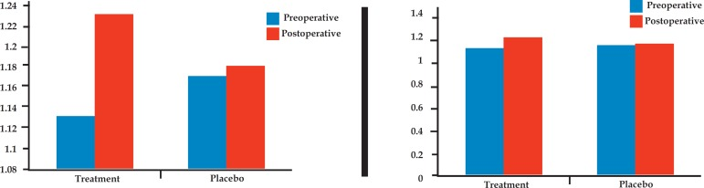
Zero on the y-axis
When zero is not present, the differences might be overstated
controversy

Slide 49
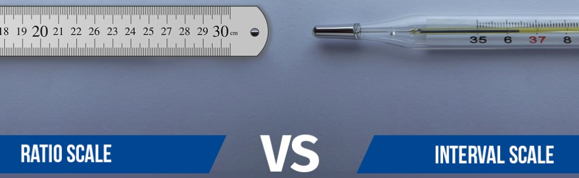
Zero on the y-axis
Zero matters
Length of stay
# of patients
Height
Weight
$
Zero is arbitrary
Temp. in C/F
SAT scores 200 - 800
Credit scores 300 - 850
controversy
Notes:
To understand my position on this, we need to revisit continuous data types

Slide 50
Zero on the y-axis: how to use
If it’s possible for your audience to interpret your data as being n times the amount, you must include zero
controversy

Slide 51
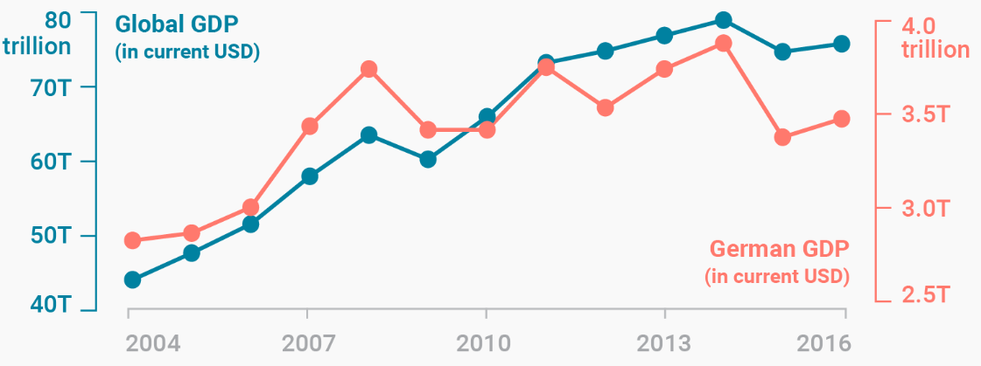
Dual y-axis
Hard to read
Relationship can be misleading
controversy
https://blog.datawrapper.de/dualaxis/

Slide 52
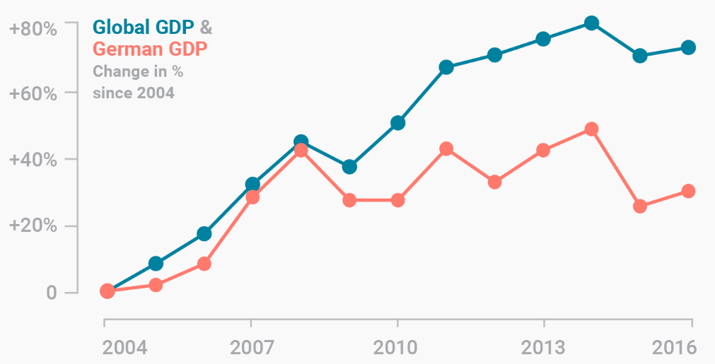
Dual y-axis: what to do instead
controversy
https://blog.datawrapper.de/dualaxis/

Slide 53
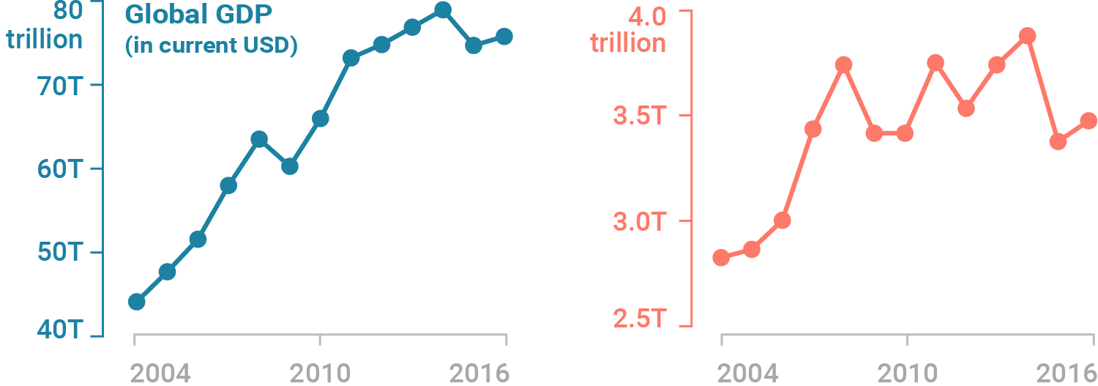
Dual y-axis: what to do instead
controversy
https://blog.datawrapper.de/dualaxis/
Notes:
Break out the lines If audience complains that a month-to-month comparison is hard, stack them.

Slide 54
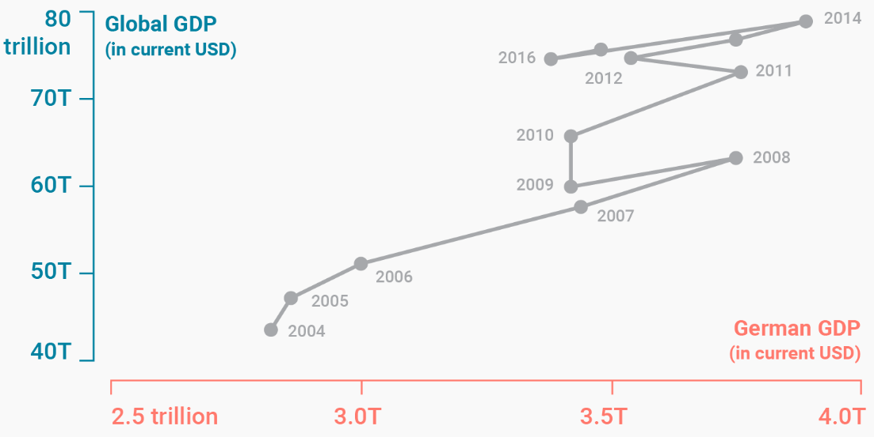
Dual y-axis: what to do instead
Connected Scatterplot
controversy
https://blog.datawrapper.de/dualaxis/
Notes:
Not as “intuitive” but also not as easy to draw the wrong conclusion

Slide 55
My thoughts

Slide 56


Data viz requires exposure
Excel has been around a long time and people are more comfortable with their charts
Less familiar charts like boxplots or invented methods may create resistance (doesn’t mean it’s bad)
🙂
😕
my thoughts
Notes:
People are familiar with the charts that have been available for decades in Excel

Slide 57

There’s no one right chart
Each of these charts are made with the same data
my thoughts

Slide 58




…and there are many yet to be discovered
my thoughts

Slide 59
Work with your end users
Creating meaningful charts requires ongoing dialogue
Expect to make edits
Balance what is insightful with what is familiar
And…
my thoughts

Slide 60

Tell people what you see
The median is 14 - 50% are < 14 and 50% are >= 14
The observations span 4 to 18.5
There are a few outliers on the lower end
The middle 50% range from 8 to 17
my thoughts

Slide 61


Recommended Reading

Slide 62
3 Takeaways
Reduce distraction
Highlight the takeaway
Remove unnecessary labels/gridlines/distraction
Help your audience
Use an informative title
Use buttons over dropdowns
Golden Ratio
Use the proportions of a credit card

Slide 63

Appendix: maps

Slide 64

Controversy: pie charts

